Slide 1
Report on Information and Communication Technologies (TIC) and Related Tools
GROUP 83
01,01,2024

Slide 3
PLAN
Introduction
Information and Communication Technologies (TIC)
Google services
Microsoft Tools
Git and Github
Conclusion

Slide 4
1) Introduction :
Information and Communication Technologies (TIC) represent a dynamic and ever-evolving domain that plays a pivotal role in shaping the contemporary global landscape.
In essence, TIC is the synergy between computing and telecommunications technologies, TIC encompasses a spectrum ranging from telecommunications networks, internet technologies, and software applications to hardware devices that enable connectivity
As we delve deeper into the intricacies of TIC in this report, we will explore key components such as Google services, Microsoft tools, Git, and GitHub, unraveling the impact of these technologies on our digital landscape

Slide 5
2) Information and Communication Technologies (TIC):
What is TCI ?
It is the infrastructure and components that enable modern computing. Among the goals of IC technologies, tools and systems is to improve the way humans create, process and share data or information with each other.
What technologies are included in TCI?
TCI encompasses the internet-enabled sphere and the mobile one powered by wireless networks. It includes antiquated technologies, such as landline telephones , all of which remain widely used alongside today's cutting-edge TCI pieces, such as artificial intelligence and robotics.
Any technology or device that enables communications between humans and between humans and machines is included in the umbrella term TCI.

Slide 6
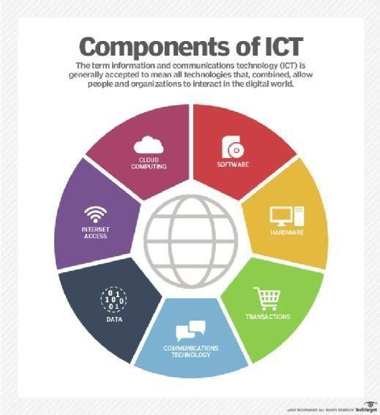
TCI components include the following :
Devices (hardware).
Software.
Middleware.
Data.
Wired networks.
Wireless networks.
Communication technologies.
The cloud.
Communications protocols and interfaces.
Information security and governance policies.

Slide 7
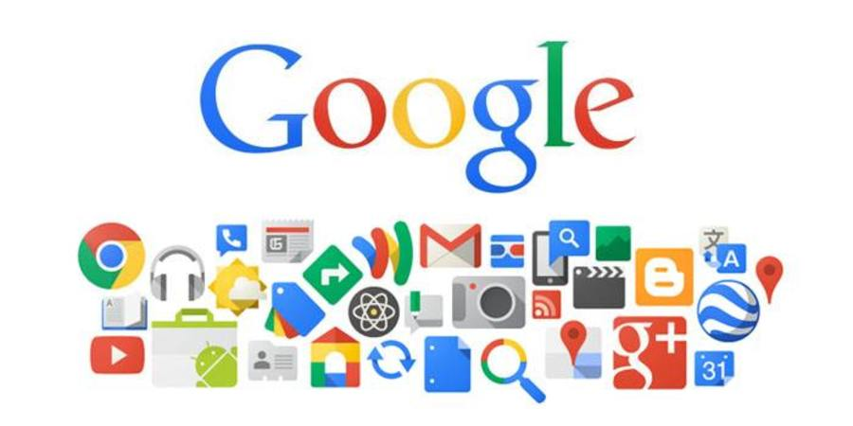
3) Google services :
Google Search : It is the world's most widely used search engine, providing
users with the ability to find information on the internet quickly.
Gmail : It is a popular email service provided by Google, known for its user-friendly
interface and efficient organization features, it is used to Send and receive emails.
Google Drive : It is a cloud storage and file-sharing service, allowing users
to store and collaborate on documents, spreadsheets, and presentations.
Google Docs, Sheets, and Slides : These are online office suite applications
for word processing, spreadsheet, and presentation creation, respectively.
Google Calendar : It is a time-management and scheduling tool that allows
users to organize events and set reminders.

Slide 8
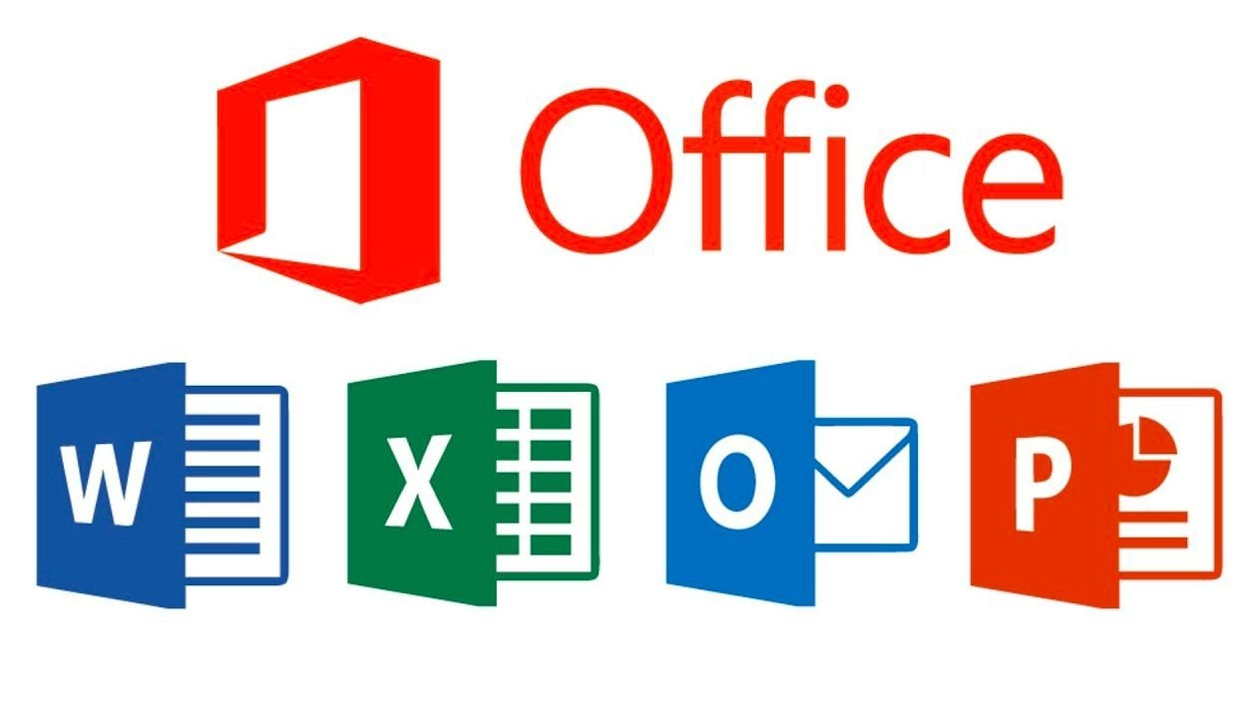


4) Microsoft Tools :
Microsoft Office Suite :
Description The Office suite includes essential applications
for personal and professional productivity.
Key Tools Word, Excel, PowerPoint, Outlook, OneNote.
Microsoft Teams :
It is a collaboration platform integrating chat, video conferencing, and file
storage, facilitating real-time collaboration and document sharing.
Azure DevOps
Visual Studio
Microsoft 365
Microsoft Power Platform
Microsoft SQL Server SQL

Slide 9


5) Git and Github :
Git : It is a distributed version control system that allows multiple developers to collaborate on projects. It tracks changes in source code during software development.
Key Features :
Decentralized version control.
Efficient branching and merging.
Local repositories for offline work.
Designed for speed and flexibility.
GitHub : It is a web-based platform that uses Git for version control. It provides hosting for software development and a collaborative environment for developers.
Key Features :
Hosting repositories in the cloud.
Collaboration features (issues, pull requests, etc.).
Web-based graphical interface.
Integration with CI/CD tools

Slide 10

Comparison Table between Git and GitHub :
Feature | Git | GitHub
Type | Version Control System (VCS) | Git repository hosting service
Usage | Local and collaboratibe developement | Collaborative develepment platform
Repository Hosting | Local and self- hosted repositories | Cloud-based hosting on GitHub
Collaboration Tools | Limited ( depends on external tools) | Issues ,pull requests , discussions
Graphical Interface | Command-line interface | Web-based graphical interface

Slide 11
6) Conclusion :
In conclusion, the realm of Information and Communication Technologies (TIC) stands as a cornerstone in our interconnected world, influencing diverse sectors and shaping the way we communicate. Through the exploration of key components such as Google Services, Microsoft Tools, and Git/GitHub, it becomes evident that TIC fosters innovation and global connectivity.
As technology continues to evolve, TIC plays a pivotal role in driving progress.
However, challenges such as data security, privacy concerns, and the digital divide remind us of the need for responsible and inclusive technology deployment.
In essence, TIC has become an integral part of our daily lives, influencing the way we work, learn, and interact.

Slide 12
The End.

